Slide 1
Copyright © 2014 Pearson Education, Inc.

Slide 2
Chapter 2
E-commerce Business Models and Concepts
Copyright © 2014 Pearson Education, Inc.

Slide 3
Tweet Tweet: What’s Your Business Model?
What characteristics or benchmarks can be used to assess the business value of a company such as Twitter?
Have you used Twitter to communicate with friends or family? What are your thoughts on this service?
What are Twitter’s most important assets?
Which of the various methods described for monetizing Twitter’s assets do you feel might be most successful?
Copyright © 2014 Pearson Education, Inc.
Slide 2-<number>

Slide 4
E-commerce Business Models
Business model
  Set of planned activities designed to result in a profit in a marketplace
Business plan
  Describes a firm’s business model
E-commerce business model
  Uses/leverages unique qualities of Internet and Web
Copyright © 2014 Pearson Education, Inc.
Slide 2-<number>

Slide 5
Eight Key Elements of a Business Model
Value proposition
Revenue model
Market opportunity
Competitive environment
Competitive advantage
Market strategy
Organizational development
Management team
Copyright © 2014 Pearson Education, Inc.
Slide 2-<number>

Slide 6
1. Value Proposition
“Why should the customer buy from you?”
Successful e-commerce value propositions:
  Personalization/customization
  Reduction of product search, price discovery costs
  Facilitation of transactions by managing product delivery
Copyright © 2014 Pearson Education, Inc.
Slide 2-<number>

Slide 7
2. Revenue Model
“How will the firm earn revenue, generate profits, and produce a superior return on invested capital?”
Major types:
  Advertising revenue model
  Subscription revenue model
  Transaction fee revenue model
  Sales revenue model
  Affiliate revenue model
Copyright © 2014 Pearson Education, Inc.
Slide 2-<number>

Slide 8
3. Market Opportunity
“What marketspace do you intend to serve and what is its size?”
  Marketspace: Area of actual or potential commercial value in which company intends to operate
  Realistic market opportunity: Defined by revenue potential in each market niche in which company hopes to compete
Market opportunity typically divided into smaller niches
Copyright © 2013 Pearson Education, Inc.
Slide 2-<number>

Slide 9
4. Competitive Environment
“Who else occupies your intended marketspace?”
  Other companies selling similar products in the same marketspace
  Includes both direct and indirect competitors
Influenced by:
  Number and size of active competitors
  Each competitor’s market share
  Competitors’ profitability
  Competitors’ pricing
Copyright © 2014 Pearson Education, Inc.
Slide 2-<number>

Slide 10
5. Competitive Advantage
“What special advantages does your firm bring to the marketspace?”
  Is your product superior to or cheaper to produce than your competitors’?
Important concepts:
  Asymmetries
  First-mover advantage, complementary resources
  Unfair competitive advantage
  Leverage
  Perfect markets
Copyright © 2014 Pearson Education, Inc.
Slide 2-<number>

Slide 11
6. Market Strategy
“How do you plan to promote your products or services to attract your target audience?”
  Details how a company intends to enter market and attract customers
  Best business concepts will fail if not properly marketed to potential customers
Copyright © 2014 Pearson Education, Inc.
Slide 2-<number>

Slide 12
7. Organizational Development
“What types of organizational structures within the firm are necessary to carry out the business plan?”
Describes how firm will organize work
  Typically, divided into functional departments
  As company grows, hiring moves from generalists to specialists
Copyright © 2014 Pearson Education, Inc.
Slide 2-<number>

Slide 13
8. Management Team
“What kind of backgrounds should the company’s leaders have?”
A strong management team:
  Can make the business model work
  Can give credibility to outside investors
  Has market-specific knowledge
  Has experience in implementing business plans
Copyright © 2014 Pearson Education, Inc.
Slide 2-<number>

Slide 14
Is Groupon’s Business Model Sustainable?
What is the value of Groupon to merchants? What types of merchants benefit the most?
What is the value of Groupon to investors?
Is Groupon overvalued?
What obstacles does Groupon face?
Which competitors present the greatest threat to Groupon?
Copyright © 2014 Pearson Education, Inc.
Slide 2-<number>

Slide 15
Major B2C Business Models
E-tailer
Community provider (social network)
Content provider
Portal
Transaction broker
Market creator
Service provider
Copyright © 2014 Pearson Education, Inc.
Slide 2-<number>

Slide 16
B2C Models: E-tailer
Online version of traditional retailer
Revenue model: sales
Variations:
  Virtual merchant
  Bricks-and-clicks
  Catalog merchant
  Manufacturer-direct
Low barriers to entry
Copyright © 2014 Pearson Education, Inc.
Slide 2-<number>

Slide 17
B2C Models: Community Provider
Provide online environment (social network) where people with similar interests can transact, share content, and communicate
  e.g.: Facebook, LinkedIn, Twitter, Pinterest
Revenue models
  Typically hybrid, combining advertising, subscriptions, sales, transaction fees, affiliate fees
Copyright © 2014 Pearson Education, Inc.
Slide 2-<number>

Slide 18
B2C Models: Content Provider
Digital content on the Web
  News, music, video, text, artwork
Revenue models
  Subscription; pay per download (micropayment); advertising; affiliate referral
Variations
  Syndication
  Web aggregators
Copyright © 2014 Pearson Education, Inc.
Slide 2-<number>

Slide 19
Battle of the Titans: Music in the Cloud
Have you purchased music online or subscribed to a music service? What was your experience?
What revenue models do cloud music services use?
Do cloud music services provide a clear advantage over download and subscription services?
Of the cloud services from Google, Amazon, and Apple, which would you prefer to use, and why?
Copyright © 2014 Pearson Education, Inc.
Slide 2-<number>

Slide 20
B2C Business Models: Portal
Search plus an integrated package of content and services
Revenue models
  Advertising, referral fees, transaction fees, subscriptions
Variations
  Horizontal/General
  Vertical/Specialized (Vortal)
  Search
Copyright © 2014 Pearson Education, Inc.
Slide 2-<number>

Slide 21
B2C Models: Transaction Broker
Process online transactions for consumers
  Primary value proposition—saving time and money
Revenue model
  Transaction fees
Industries using this model
  Financial services
  Travel services
  Job placement services
Copyright © 2014 Pearson Education, Inc.
Slide 2-<number>

Slide 22
B2C Models: Market Creator
Create digital environment where buyers and sellers can meet and transact
  e.g.: Priceline, eBay
Revenue model
  Transaction fees
Copyright © 2014 Pearson Education, Inc.
Slide 2-<number>

Slide 23
B2C Models: Service Provider
Online services
  e.g.: Google—Google Maps, Gmail, etc.
Value proposition
  Valuable, convenient, time-saving, low-cost alternatives to traditional service providers
Revenue models
  Sales of services, subscription fees, advertising, sales of marketing data
Copyright © 2014 Pearson Education, Inc.
Slide 2-<number>

Slide 24
B2B Business Models
Net marketplaces
  E-distributor
  E-procurement
  Exchange
  Industry consortium
Private industrial network
Copyright © 2014 Pearson Education, Inc.
Slide 2-<number>

Slide 25
B2B Models: E-distributor
Version of retail and wholesale store, MRO goods, and indirect goods
  e.g.: Grainger.com
Owned by one company seeking to serve many customers
Revenue model
  Sales of goods
Copyright © 2014 Pearson Education, Inc.
Slide 2-<number>

Slide 26
B2B Models: E-procurement
Creates digital markets where participants transact for indirect goods
  B2B service providers, application service providers (ASPs)
  e.g.: Ariba
Revenue model
  Service fees, supply-chain management, fulfillment services
Copyright © 2014 Pearson Education, Inc.
Slide 2-<number>

Slide 27
B2B Models: Exchanges
Independently owned vertical digital marketplace for direct inputs
Revenue model
  Transaction, commission fees
Create powerful competition between suppliers
Tend to force suppliers into powerful price competition; number of exchanges has dropped dramatically
Copyright © 2014 Pearson Education, Inc.
Slide 2-<number>

Slide 28
B2B Models: Industry Consortia
Industry-owned vertical digital marketplace open to select suppliers
  E.g.: Exostar
More successful than exchanges
  Sponsored by powerful industry players
  Strengthen traditional purchasing behavior
Revenue model
  Transaction, commission fees
Copyright © 2014 Pearson Education, Inc.
Slide 2-<number>

Slide 29
Private Industrial Networks
Digital network
Used to coordinate communication among firms engaged in business together
Typically evolve out of company’s internal enterprise system
e.g.: Walmart’s network for suppliers
Copyright © 2014 Pearson Education, Inc.
Slide 2-<number>

Slide 30
E-commerce Enablers:
The Gold Rush Model
E-commerce infrastructure companies have profited the most:
  Hardware, software, networking, security
  E-commerce software systems, payment systems
  Media solutions, performance enhancement
  CRM software
  Databases
  Hosting services, etc.
Copyright © 2014 Pearson Education, Inc.
Slide 2-<number>

Slide 31
How the Internet and the Web
Change Business
E-commerce changes industry structure by changing:
  Rivalry among existing competitors
  Barriers to entry
  Threat of new substitute products
  Strength of suppliers
  Bargaining power of buyers
Copyright © 2014 Pearson Education, Inc.
Slide 2-<number>

Slide 32
Industry Value Chains
Set of activities performed by suppliers, manufacturers, transporters, distributors, and retailers that transform raw inputs into final products and services
Internet reduces cost of information and other transactional costs
Leads to greater operational efficiencies, lowering cost, prices, adding value for customers
Copyright © 2014 Pearson Education, Inc.
Slide 2-<number>

Slide 33
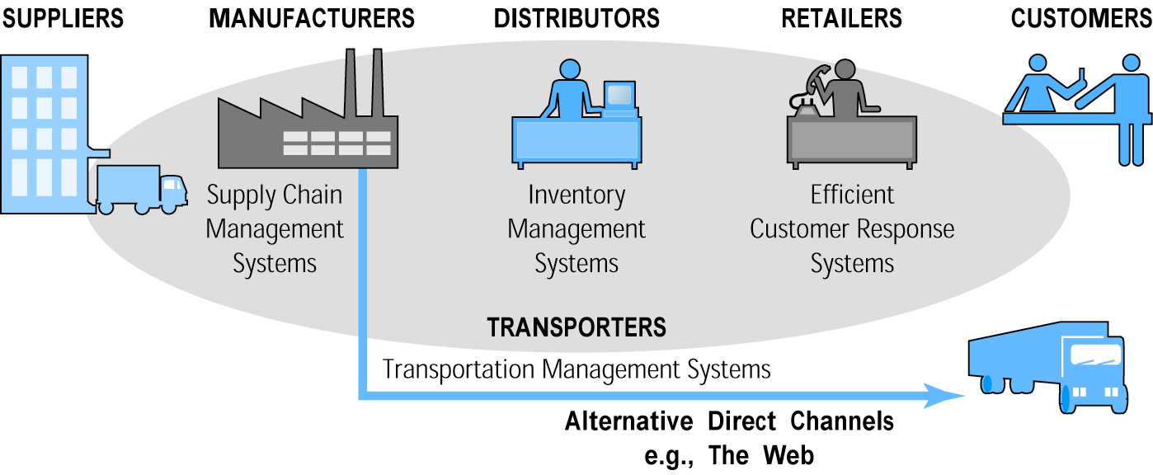
E-commerce and Industry Value Chains
Figure 2.3, Page 55
Copyright © 2014 Pearson Education, Inc.
Slide 2-<number>

Slide 34
Firm Value Chains
Activities that a firm engages in to create final products from raw inputs
Each step adds value
Effect of Internet
  Increases operational efficiency
  Enables product differentiation
  Enables precise coordination of steps in chain
Copyright © 2014 Pearson Education, Inc.
Slide 2-<number>

Slide 35
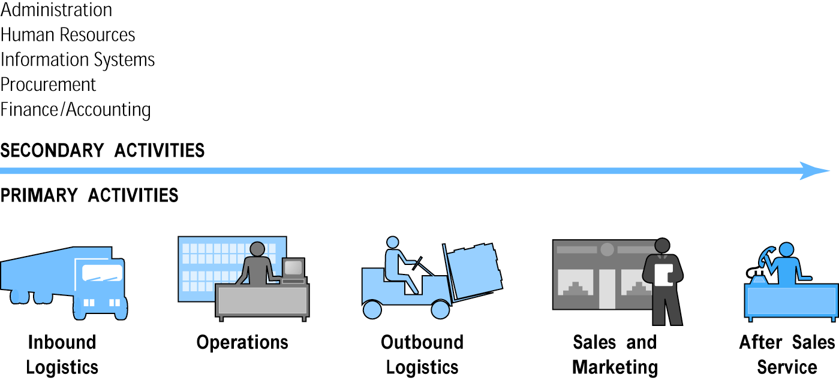
E-commerce and Firm Value Chains
Figure 2.4, Page 56
Copyright © 2014 Pearson Education, Inc.
Slide 2-<number>

Slide 36
Firm Value Webs
Networked business ecosystem
Uses Internet technology to coordinate the value chains of business partners
Coordinates a firm’s suppliers with its own production needs using an Internet-based supply chain management system
Copyright © 2014 Pearson Education, Inc.
Slide 2-<number>

Slide 37
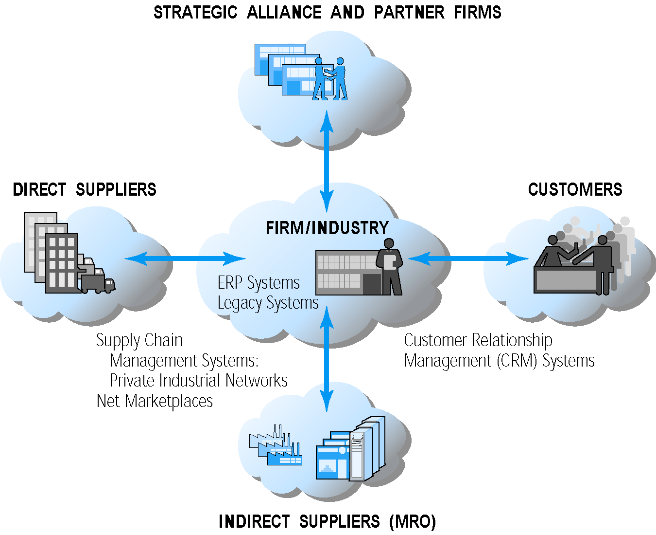
Internet-enabled Value Web
Figure 2.5, Page 57
Copyright © 2014 Pearson Education, Inc.
Slide 2-<number>

Slide 38
Business Strategy
Plan for achieving superior long-term returns on the capital invested in a business firm
Four generic strategies
  Differentiation
  Cost
  Scope
  Focus
Copyright © 2014 Pearson Education, Inc.
Slide 2-<number>

Slide 39

Copyright © 2014 Pearson Education, Inc.
Slide 2-<number>

